Slide 1
In the Federal Aviation Administration
Project Management Professional
Celeste Flemming
Notes:
FPIF
Fixed Price Incentive Fee
FS
Finish to Start
IFB
Invitation For Bid
LF
Late Finish Date
LOE
Level of Effort
LS
Late Start Date
OBS
Organizational Breakdown Structure
OD
Original Duration

Slide 2
Objectives
Describe Federal Aviation Administration Acquisition professionalization requirements
Describe the Project Management Professional “PMP”
Describe the components/steps of Project Management per the PMBOK (Project Management Book of Knowledge
Identify what is considered a project
Describe what project managers do
Consider how projects inside your work area could be improved by using PMP methods/principles
Consider whether you wish to become a PMP and if so how you might begin

Slide 3
History/Background
April 2005: OMB issued Policy Letter
“Developing and Managing the Acquisition Workforce” which established requirements for federal agencies to place structure around acquisition certification programs
April 2007: OMB approved the Federal Acquisition Certification for Program/Project Managers (FAC-P/PM)
Notes:
Don’t be put off by the link to “Acquisition”!!! The Certification group sees project managers as ALL part of the Acquisition Workforce. After all, how could I be managing a 5 million project, for example, WITHOUT an acquisition being involved? So PMs are all intricately linked with acquisition process.

Slide 4
What is “PMP”
Project Management Professional - certification
An external credential
Requires passing a 200-question multiple choice test, which requires preparation
Agency may not fund exam/prep
Requires continuing education to maintain
Requires periodic renewal of credential
PMP is more than Microsoft Project and GANTT charts. It is a skillset that will help you (and the government you work for) perform better.
Notes:
60 PDUs per 3-year cycle. I think I studied 80 hours.

Slide 5
PMP Certification Requirements
High school diploma or associate’s degree with at least five years of project management experience, with 7,500 hours leading and directing projects and 35 hours of project management education.
OR
A four-year degree (bachelor’s degree) and at least three years of project management experience, with 4,500 hours leading and directing projects and 35 hours of project management education.
Notes:
Must write up your project management experience, subject to audit.

Slide 6
Why I Did It
I’ve been managing projects my whole career but I never really knew how to do it
Now I finally feel like I know how to do it!
I am confident about taking on larger projects, because I know what it takes to accomplish them
I learn from the continuing education activities like PMI meetings and conferences.
I meet people I would not otherwise meet and learn things I would not otherwise learn.
There have even been details available related to having a PMP
Some assignments in my work are seen by management as better executed by a credentialed PMP

Slide 7
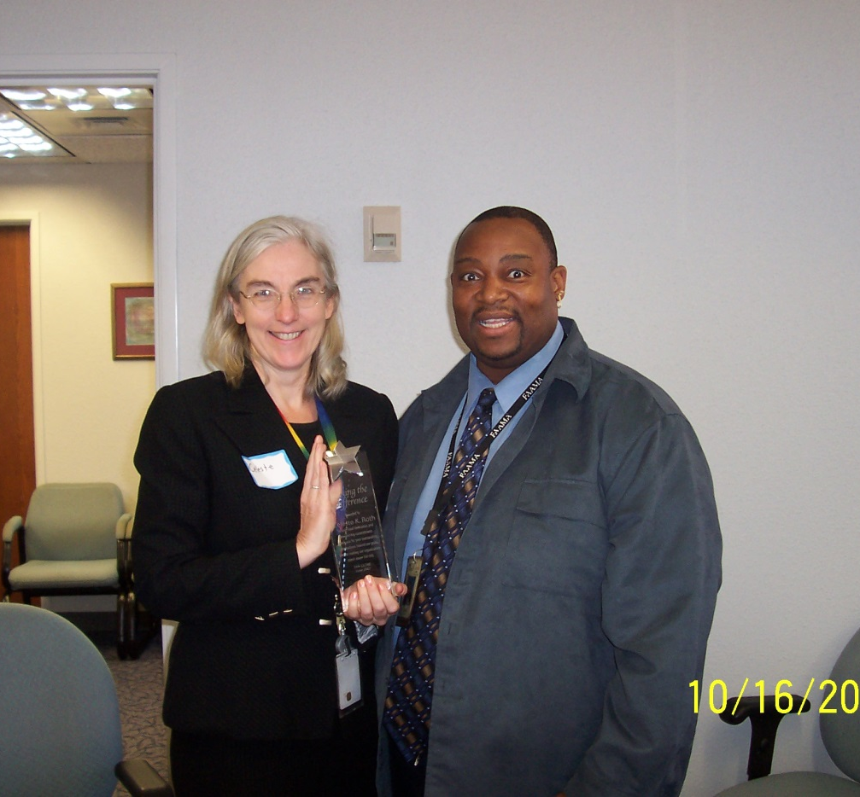
The value of a common set of steps and terminology when teams are communicating about a project
Notes:
Specific definitions of terms related to how projects progress. So we know we are talking about the same thing.

Slide 8

The value of a common language and structure when evaluating projects competing for the same resources at an agency level
Notes:
Apples to apples

Slide 9
Project Management Professional
http://www.pmi.org/
Project Management Book of Knowledge (PMBOK)
Standards for project management
Standards for project managers
Notes:
Including ethics, minimum credentials, and ongoing professional support.

Slide 10
What is Project Management?
A project is temporary in that it has a defined beginning and end in time, and therefore defined scope and resources.
And a project is unique in that it is not a routine operation, but a specific set of operations designed to accomplish a singular goal.
Project management, is the application of knowledge, skills and techniques to execute projects effectively and efficiently.
Must be expertly managed to deliver the on-time, on-budget results, learning and integration that organizations need.
Notes:
Something must be done which has not been
done before
The undertaking ends with a specific accomplishment
Required activity has a beginning, an end and a schedule for completion
Resources are limited
Progressively Elaborated
Phases and activities are sequenced

Slide 11
Activity
Write down a few things that you consider projects in your workplace.

Slide 12

PMP-defined project domains
Initiating
Planning
Executing
Monitoring and Controlling
Closing
Sequenced steps and Activities
Notes:
What stage are the projects you wrote down in right now?

Slide 13
Project management knowledge draws on ten areas
Scope
Quality
Communications
Time
Procurement
Risk Management
Cost
Human Resources
Stakeholder Management
Integration
:

Slide 14
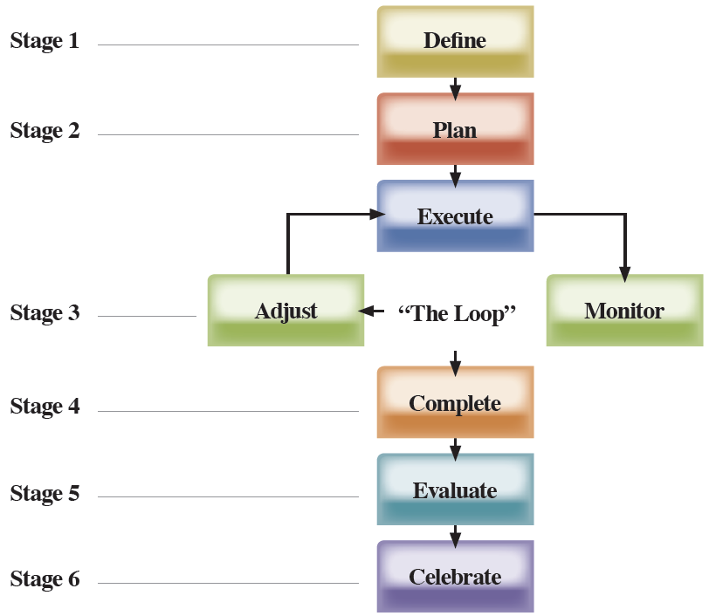
Project Management Process
Notes:
The six-stage project management process
Once you have established a clear goal for your project you have to consider how you are going accomplish the goal. You now have a starting point and an ending point so you need to figure out how you’re going to get from the beginning to the end. That’s where the six-stage project management process comes in. Understanding these six-stages will guide you to your goal and become your roadmap to success.
This diagram comes from Michael Dobson's book, Practical Project Management (Pp. 9-14). "The key lesson of the project life cycle is this: each step depends on its predecessor. To manage your project successfully, do the work in this order" (P. 9).
• Define.
Dobson: "Before you can ever do a competent job managing a project, you must first define what you're doing and why. . . While a good goal will not guarantee a successful project, the lack of a good goal guarantees failure" (P. 9).
• Plan
Dobson: "Planning is the technical heart of the discipline known as project management. . . Planning has two major virtues:
1. A good plan teaches you about your project.
2. Any plan, whether good or not, helps you monitor where your project is, compared to where it should be" (P. 9).
• "The Loop."
"This process is called 'the Loop' because it contains the three steps you repeat in sequence throughout the management phase until your project is complete.
Execute. This is the process of assigning tasks to team members and ensuring that they carry out the work.
Monitor. Compare the tasks being completed to the plan. Is the work being completed on time, on budget, and according to performance specifications?
• Adjust. Whenever monitoring reveals a discrepancy between plan and reality, it's time to make adjustments. The earlier you find a problem, the easier it is to solve" (P. 11).
• Complete.
"It may seem like an exercise in the blindingly obvious to point this step out, but a project isn't finished until it's complete. . . .You may be wondering why make a fuss about some unfinished projects-if they're not being worked on, there's no current expenditure, right? Wrong. These projects consume opportunity costs and morale dollars merely by existing. Finish them or shoot them-there's no happy medium" (P. 13).
• Evaluate
Dobson: "The savvy project manager always evaluates each project, not to fault-find, but rather to gain wisdom for the future" (P. 14).

Slide 15
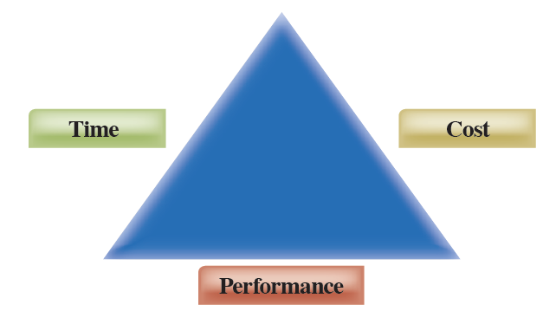
Triple Constraints
Notes:
How do you find out the constraints and priority? Ask questions!
• Time: How long do you have to complete the project?
• Cost: How much money and what resources do you have to spend on the project?
• Performance: What results must your project achieve to meet its purpose?
(Good Story to explain Triple Constraints)
The Three Headed King and the Triple Constraint
There once was a three headed king who lived a very conflicted life, for each of his heads had a different focus in life. One head always wanted bigger and better things; we will call this head “scope”. The second head always wanted to be punctual; we will call this head “time”. The third head was concerned about how expensive things were; we will call this head “cost”. The king seemed to be happiest when all three heads could balance their interests.
The king decided to add a tower to his castle which would allow him to climb to the top and view his whole kingdom. It was important to the king that the tower was completed before a big celebration in his kingdom so that he could view all his subjects as they traveled to the celebration. The king appointed a project manager to make sure that the tower would be completed while keeping scope, time, and cost happy.
The project manager was pleased with the opportunity to serve the king, yet was concerned that if he could not keep scope, time, and cost happy…heads would roll. With this challenge in place, the PM rolled up his sleeves and put together a plan which would meet the king’s needs and allow him to keep his head. He gathered the surfs together and construction began.
One day, scope approached him with a change to the original plans for the tower. He decided that since it was a long climb to the top of the tower, a lounge half way up the tower would be splendid so he could rest half way up. The lounge would be adorned with a hot tub, lounge chairs and a big screen TV. Since the king was the sponsor of the project, the PM agreed to figure out what effect this change would have upon the completion of the tower. After analysis, the PM realized that the lounge would cause a one month delay to the completion of the project and would cost one additional bag of gold.
The Project Manager realized that the change scope wanted would cause the tower to be completed two weeks after the king’s celebration and was definitely more expensive than what cost approved. With this in mind, the PM shared his analysis with the king. Immediately time and cost vetoed the request, yet conceded that the idea of a lounge would be a nice addition to the tower. The PM, being the cleaver fellow he was and remembering how nice he thought his head looked where it was, did some quick calculations and presented an alternative solution to the king. “If dear king, we built a lounge for you to rest yet only adorn it with a lounge chair, we can complete the tower in time for the celebration and for only half a bag of gold.” With that, scope, time, and cost were happy and the king approved the change.
A short time later the tower was completed with the lounge included. At the king’s celebration, the project manager was knighted…with his head intact.
The Triple Constraint
In project management there is a key concept called the triple constraint or the project management triangle. The idea is that while managing a project the PM must keep three constraints in balance; the scope or work that is required to produce the projects end results, the amount of time required to perform the work, and the cost or budget for the project. As illustrated with the three headed king, scope, time and cost are almost always competing constraints. Typically, you cannot change one constraint without affecting one or both of the other constraints.
As a sensible project manager, remember that as change happens, it is important to keep these three constraints balanced…if you want to keep your head and your job.

Slide 16
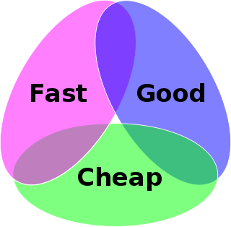
In other words….”pick two”

Slide 17

Initiating
Define Scope
Define Outcome
Obtain commitment and signature of authorizing officials
The Charter
Next Step is plan the project

Slide 18

The Fundamentals of Project Planning
Plan the project
Notes:
In this session, you will learn or revist how to implement the basic aspects of project planning. The planning stage helps you assess possible set-backs and create plans to address these issues. You will learn how to budget your time for projects and how to allocate your resources.

Slide 19
Work Breakdown Structure
Project
Task 1
Task 1.1
Task 1.2
Task 2
Task 2.1
Task 3
Task 2.2
Task 3.1
Task 3.2
Notes:
Planning all three parameters of a project starts with the work breakdown structure (WBS). This technique operates on the "divide and conquer" theory, by identifying the subunits or "work packages" of a project. By identifying all of the elements required to bring the project to a successful completion, the chances of overlooking or neglecting an essential step are reduced.
A work breakdown structure is a deliverable-oriented grouping of project elements that organizes and defines the total scope of the project: work not in the WBS is outside the scope of the project. As with the scope statement, the WBS is often used to develop or confirm a common understanding of project scope. Each descending level represents an increasingly detailed description of the project elements" (P. 54).
From Meredith and Mantel: "The Work Breakdown Structure (WBS) is not one thing. It can take a wide variety of forms that, in turn, serve a wide variety of purposes. The WBS often appears as an outline with the Level 1 tasks on the left and successive levels appropriately indented. . . Most current project management software will generate a WBS on command. Microsoft's Project 98, for example, links the indented activity levels with a Gantt chart that visually shows the activity durations at any level" (P. 203).
Meredith and Mantel: "Some writers recommend using the WBS as the fundamental tool for planning. We find nothing logically wrong with this approach, but it seems overly structured when compared to the way that firms noted for high-quality planning actually proceed. . . Other writers pay scant attention to the WBS, giving the subject little more than a mention. We do not find this a fatal error as long as the planning activity is otherwise carried out to an appropriate level of detail.
Meredith and Mantel: "In general, the WBS is an important document and can be tailored for use in a number of different ways. It may illustrate how each piece of the project contributes to the whole in terms of performance, responsibility, budget, and schedule. It may, if the PM wishes, list the vendors or subcontractors associated with specific tasks. It may be used to document that all parties have signed-off on their various commitments to the project.. . .Its uses are limited only by the needs of the project and the imagination of the PM" (P. 203).
Heldman (2002): "There is some controversy among project managers over whether activities should be listed on the WBS. There isn't a rule in the Guide to the PMBOK regarding this; it's up to the project manager to determine how far to break the deliverables down and whether to include activities. . . . Large projects made up of a series of smaller subprojects will likely break the project down to a work package level. In this case, the work package is a collection of related tasks. The work packages can then be assigned to individual managers who will in turn break them down into activities during the activity definition process later in the planning process" (P. 136).
Mintzer: Attention! "One of the mistakes project managers frequently make is breaking down or subdividing activities into countless smaller tasks or chores. When the pie goes from slices to crumbs, you're in trouble. . . First of all, at that level of detail, the project manger has left no room for changes in this tight and lengthy schedule. There is also no room for skilled professionals to take the ball and run with it, which in many cases produces faster, more effective results." A Work Breakdown Structure that is too rigid and too detailed leads to micro-management, which doesn't usually enhance the team spirit" (P. 46).

Slide 20

Work Breakdown Structure allows…
Estimating costs of each part of the work
Estimating personnel needed
Estimating the time needed for each task
Sequencing the work packages
Notes:
Discuss “padding” and “management reserve” and stuff

Slide 21
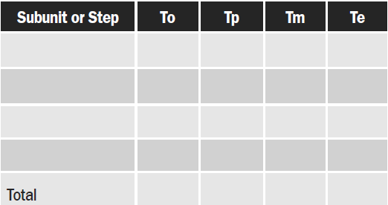
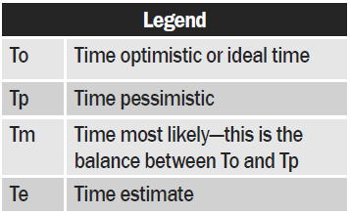
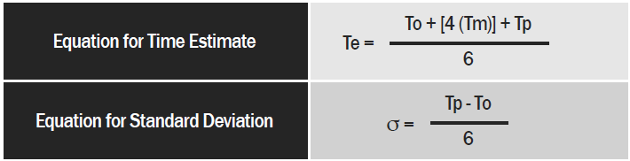
Planning the Time Dimension
Notes:
Planning the time dimension—how to use PERT, Gantt, and CPM charts and choosing the technique best suited to your needs
The most important aspect of planning is time management. Learning how to manage and budget your time for a project is crucial to the success of your project.
Planning the Time Dimension:
Three most important time elements:
1. Duration of each step
2. Earliest time at which a step may be started
3. Latest time at which a step must be started

Slide 22
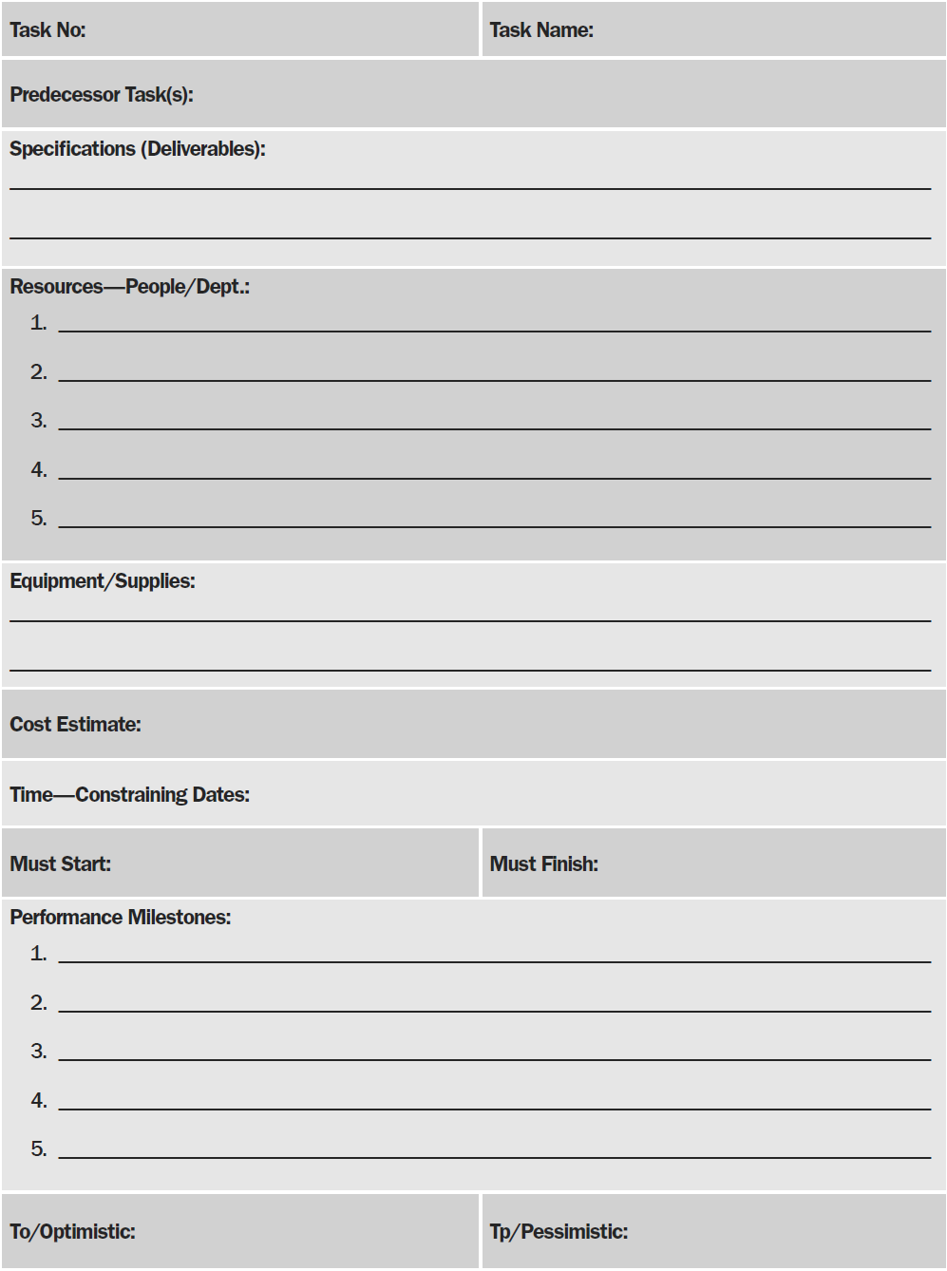
Task Analysis Form

Slide 23
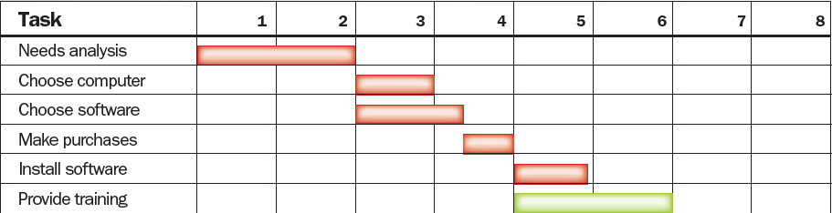
Gantt Charts
18
Notes:
A Gantt chart is a bar chart which provides an easy-to-read visual picture of activities, events and milestones. These charts also show the sequencing of events. Gantt charts are relatively easy to construct, understand and change. The major disadvantage of this kind of chart is that no information is given about overall project status, and the interdependence of the project tasks is not apparent

Slide 24
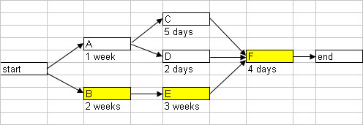
Critical Path Method (CPM)
Notes:
CPM also known as critical path analysis is a mathematical formula for identifying those tasks which are critical to the project and their order in the process for successful project completion. In this method, you can determine how to allocate your resources so you can get the best results and make time estimations on tasks
The main use of the CPM is to create a model of your project that includes these main parts:
1. A Work Breakdown Structure (WBS) that lists the tasks required to complete the project
2. The time that it takes to complete each task
3. Shows you how different tasks are dependent on each other
CPM chart consists of multiple paths.
• Paths: The length of a path is the sum of the tasks on the path.
• Critical Path: The tasks critical to complete the project and the longest path(s) in duration
• Slack: The extra time available to complete noncritical tasks
• Float: Task that can be delayed without having an impact on the project’s deadline

Slide 25
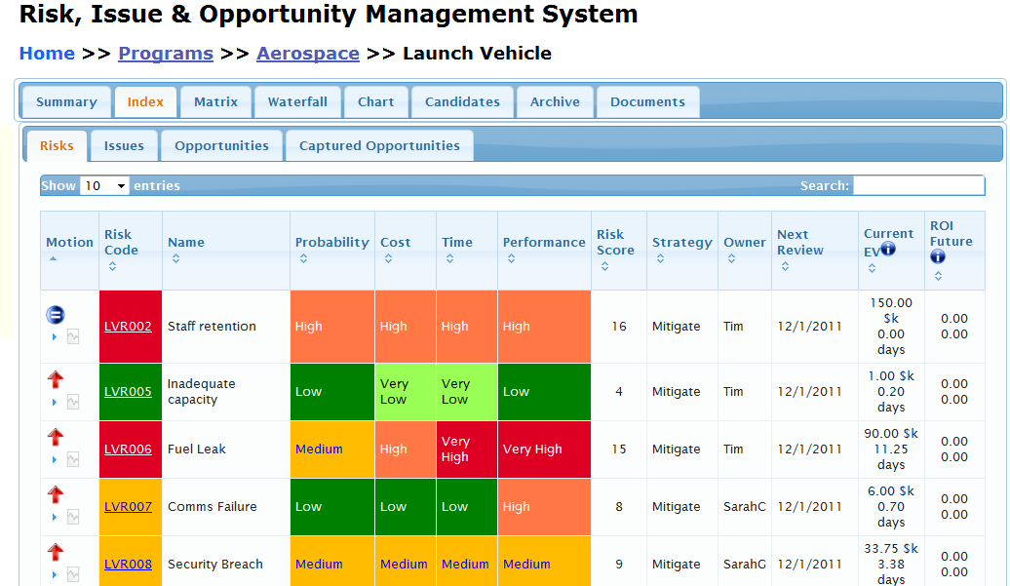
Analyze Risks
Notes:
Mitigate, Retain, Transfer, Ignore—contingency plans define what you are going to do in case.

Slide 26
Provide for Contingencies in Project Plans
Mitigate
1
Retain
2
Transfer
3
Reducing the risk or severity of loss during the course of the project.
Accepting a loss when it happens and moving on. This can reduce the quality of your project or increase your cost.
Passing the risk or loss on to another party. Contracting out to another party.
Notes:
Three commonly accepted ways to provide for contingencies in project plans, and which one top project managers prefer
When you make a contingency plan for your project you are establishing a “Plan B” in case your project goes off-track. Consider the obstacles you may face during your project and how you plan to resolve them when creating a contingency plan, be objective and consider the risks during the process of completing your project.
Develop an outline for every contingency plan and action item within each contingency plan.
Building, implementing and managing a contingency plan requires resources just as any other project. Therefore, like other projects, it is best to develop a quick outline (proposal) for each contingency plan describing the risks the plan addresses, how it addresses the risks, etc., then seek approval to build each plan.
The term "contingency action" is mentioned in the task title to remind analysts that taking action to minimize risks is just as much a part of contingency planning as developing a plan to react to circumstances. For instance, many manufacturing companies that use Just In Time inventory practices are stocking up on vital supplies to prevent disruption of their supply chain dependent business. This requires them to secure warehouse space, transportation to and from the new inventory locations, etc. All these actions are proactive rather than waiting until a critical supplier informs them of a problem.
Here are some considerations when defining contingency plans:
1. Have further discussion with team members to determine confidence in corrective measures already taken and what could practically be added.
2. Further contact with vendor/customer to determine contingency measures they may be taking.
3. Consider what engineering or other actions may be practical to reduce or eliminate risk.
4. Consider and include measures to reduce, eliminate, or compensate for damage, such as:
• insurance
• standby personnel
• standby or retained outside resources
• hedges
• temporary operational changes
5. Review all planned actions with respect to cost, practicality, time to complete, secondary benefits, undesirable side effects, or other factors.
A suggested template for a contingency plan outline is shown in Appendix C of this workbook. The following list describes each field on the template:
A unique identification number assigned to each contingency plan. Note that the database tool does not allow duplicates, so each contingency plan requires a unique number.
A name for each contingency plan.
The business function ID and name that the plan applies.
The business function ID and name that the business function is part of.
A brief description of the risks or problems that the plan addresses.
Indicate the probability of the failure occurring as recorded in the prior section on risk analysis.
Indicate the criticality of each risk type based on rating factors assigned in the prior section on risk analysis.
A brief description of how the business function is to operate while the plan is in effect. Note that this is not a description of how to fix the problem. The purpose of this plan is to describe how to continue business in light of the problems. Fixing the problem that caused the contingency plan to go into effect is a separate (but related) plan that can be included in the plans for each system, interface and 3rd party.
A clear definition of the failure scenario that will cause this plan to be implemented. This is referred to as a trigger. Most triggers are either a date or condition. For instance, you might contract with a new/backup supplier if your primary supplier cannot guarantee that they can meet your demands by a certain date or that you will immediately shut down an operation if a monitoring system indicates dangerous levels.
A clear definition of the condition that will allow you to retract a contingency plan. Same as above except the trigger is focused on eliminating the contingency plan. For instance, the operation that was shut down is to be brought back up after manual review and remediation of the problem causing the shut down.
Estimates of the costs to build, implement, manage, and retire the plan.
A high level summary of the plan itself. Be sure to include the tasks, responsible parties for each task and estimated start dates or conditions for each task in this summary.
Optional: It is common to include a summary plan describing how the problem will be fixed while the contingency plan is in effect. For instance, your plan describes that an operation is to be shut down due to a malfunctioning system. This optional technical plan describes how the system will be fixed while your operations are down.

Slide 27

Getting Down To Work
Execute your project

Slide 28

Team Member Task Assignments Must Include Some Give and Take
Notes:
Team members constantly negotiate tasks and assignments throughout a project. Teams share the burden of a project so no one is overwhelmed with the project. Team work is about trust, collaboration, and cooperation. If team members don’t help each other, then the team is not going to be effective or efficient.
Team member task assignments must include give and take because a project can easily overwhelm a single person. If team members share the burden of the project (take the burden off of a single person) then the project and the assignments will be less daunting. Team members can then divide the project tasks so it can be conquered. The process of give and take doesn’t happen without some work; team members have to build relationships, trust each other, and they have to develop job and interpersonal skills.

Slide 29

Monitoring and Controlling
Monitor the project
Notes:
The foundation for monitoring and controlling will rely on your project plan. Look to your plan as you monitor the progress of the project through project reports and costs. Control aspects that are not consistent with your goals by referring to the project milestones.
Monitoring and Controlling Project Work
Considering that the Project Management Plan is the baseline for the project. This is guide for monitoring and controlling the project. As a project manager, one will need access to work performance information, performance reports, and change request. This information will need to be at your fingertips as inputs to yield project performance indicators. After analyzing and reviewing the information, it is time to decide whether corrective or preventative actions are needed.
The four inputs to monitoring and controlling project work are:
1. Project Management Plan – The project management plan is the main source of information about how the project will be executed, monitored, and controlled. It is the plan, with all additional subsidiary plans as needed.
2. Work performance information – Work performance information is the information about project activities. This includes status information about progress, deliverables, expenses, and quality assurance validations.
3. Rejected change requests – Reject change request can be enlightening when reviewed in the context of determining how the progress of the project is fairing.
Remember the quality of the measurement is only as good as the data gathered to ascertain the measurement. While it may take time, being vigilant and reviewing this information will save one headaches in the long run.
So how do you sort through the granular details and formulate it into information? Well the good news is this isn’t a single problem, it affects all project managers, and there are standardized tools and techniques for monitoring and controlling project work.
These tools and techniques are:
• Expert judgment - On the basis of current project information and experience with similar projects, project managers and team members can use expert judgment to make decisions, such as whether to take corrective or preventive actions.
• Earned value technique (EVT) – Earned Value Technique (EVT) provides project managers with a means of calculating current project schedule and cost performance. Project managers can then use this information to forecast future schedule and cost performance.
• Project management methodology – The organizational project management methodology provides project managers with detailed guidance and procedures to enable effective monitoring and control through each stage of a project.
• Project management information system (PMIS) - A PMIS allows for monitoring and controlling parameters such as cost and resource usage. A PMIS can also enable project managers to calculate and manage earned value information, as well as request and update project information automatically.
Using the correct tools and techniques will help keep you in the loop of what’s going on with your project.
Obviously as one monitors and controls there will be some action items that occur. These action items cycle back into the project execution. So what are some outputs or action items that occur during the Monitor and Control Project Work process?
The outputs of monitoring and controlling project work are:
• Recommended corrective actions - These are based on project work performance information. By comparing this information to the project plan, the project manager or team uses expert judgment to put forward ideas to remedy problems that have arisen.
• Recommended preventive actions - These are based on project work performance information. By comparing this information to the project plan, the project manager or team uses expert judgment to suggest ways of avoiding project risks.
• Forecasts - Based on work performance information received during the Monitor and Control Project Work process, forecasts allow the prediction of successful or unsuccessful project outcomes.
• Recommended defect repairs - These are an output of monitoring and controlling project work. This output recommends the remedial work necessary when a product does not meet quality requirements.
• Requested changes - These are revised actions that are necessary for meeting project objectives. The requests are often made by the project manager or members of the project team as a way of improving methods or overcoming problems.
Just keep in mind that every organization is different, and your experiences of monitoring and controlling project work will depend on your company's project management methodology and the type of project.

Slide 30

Structure Reports for Maximum Value
Reports on performance, schedule, costs
Reports should be as brief as possible
Target the report (don’t try to circulate one report to too many recipients)
Use pictures, demonstrations and models
Notes:
Reports are only as accurate as the information in them. Make certain the figures and information are accurate and up-to-date. Use specific details and information to demonstrate where the project stands in the process.
How to structure reports for maximum value
Maximizing the effectiveness of reports
Baker and Baker (2000) make a good point. You shouldn't assume that your team members know how to write or interpret status reports. Make sure that you train them so that they will take the reports seriously.
• Reports may concern performance, schedule or cost
• Reports should always be as brief as possible
• Target the report (don't try to circulate one report to too many recipients)
• Use pictures, demonstrations and models (don't limit report medium to writing)

Slide 31
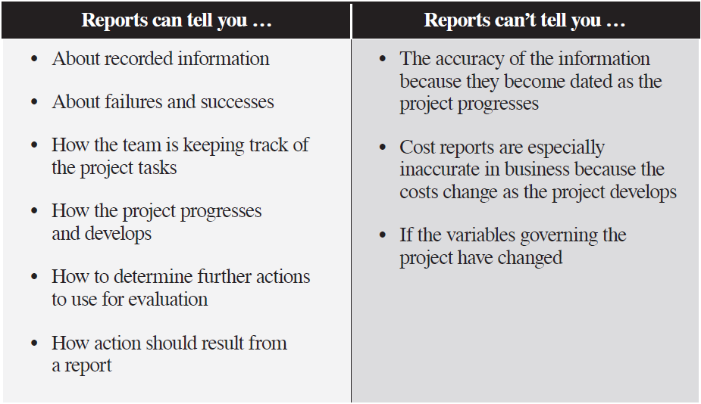
Written Reports …
Notes:
Projects are constantly moving forward so a written report will be accurate as long as the project hasn’t moved to the next phase in development and the variables governing the process haven’t changed.

Slide 32

Determine How Much Detail Reports Should Include and What the Distribution Should Be
Notes:
Reports should be brief and focus on the information (or problem) you are dealing with for the project. You need to target information, back it up with facts and describe the tools you used to gather information. Finally you have to suggest recommendations in your conclusion.
How much detail reports should include and what distribution should be:
• Start with an informal executive summary
• Isolate the subject and collect relevant data
• Determine the scope of the report
• Remember your audience will often be upper level management
• Describe the specific quantitative tools that will be used to accomplish the preferred results for the project
o Use statistical information and graphs to show progress
▪ Statistics from performance assessments (improvement or decline in performance of specific tasks)
▪ Gantt charts
▪ Work Breakdown Structure (WBS)
▪ PERT charts
▪ Budgets

Slide 33
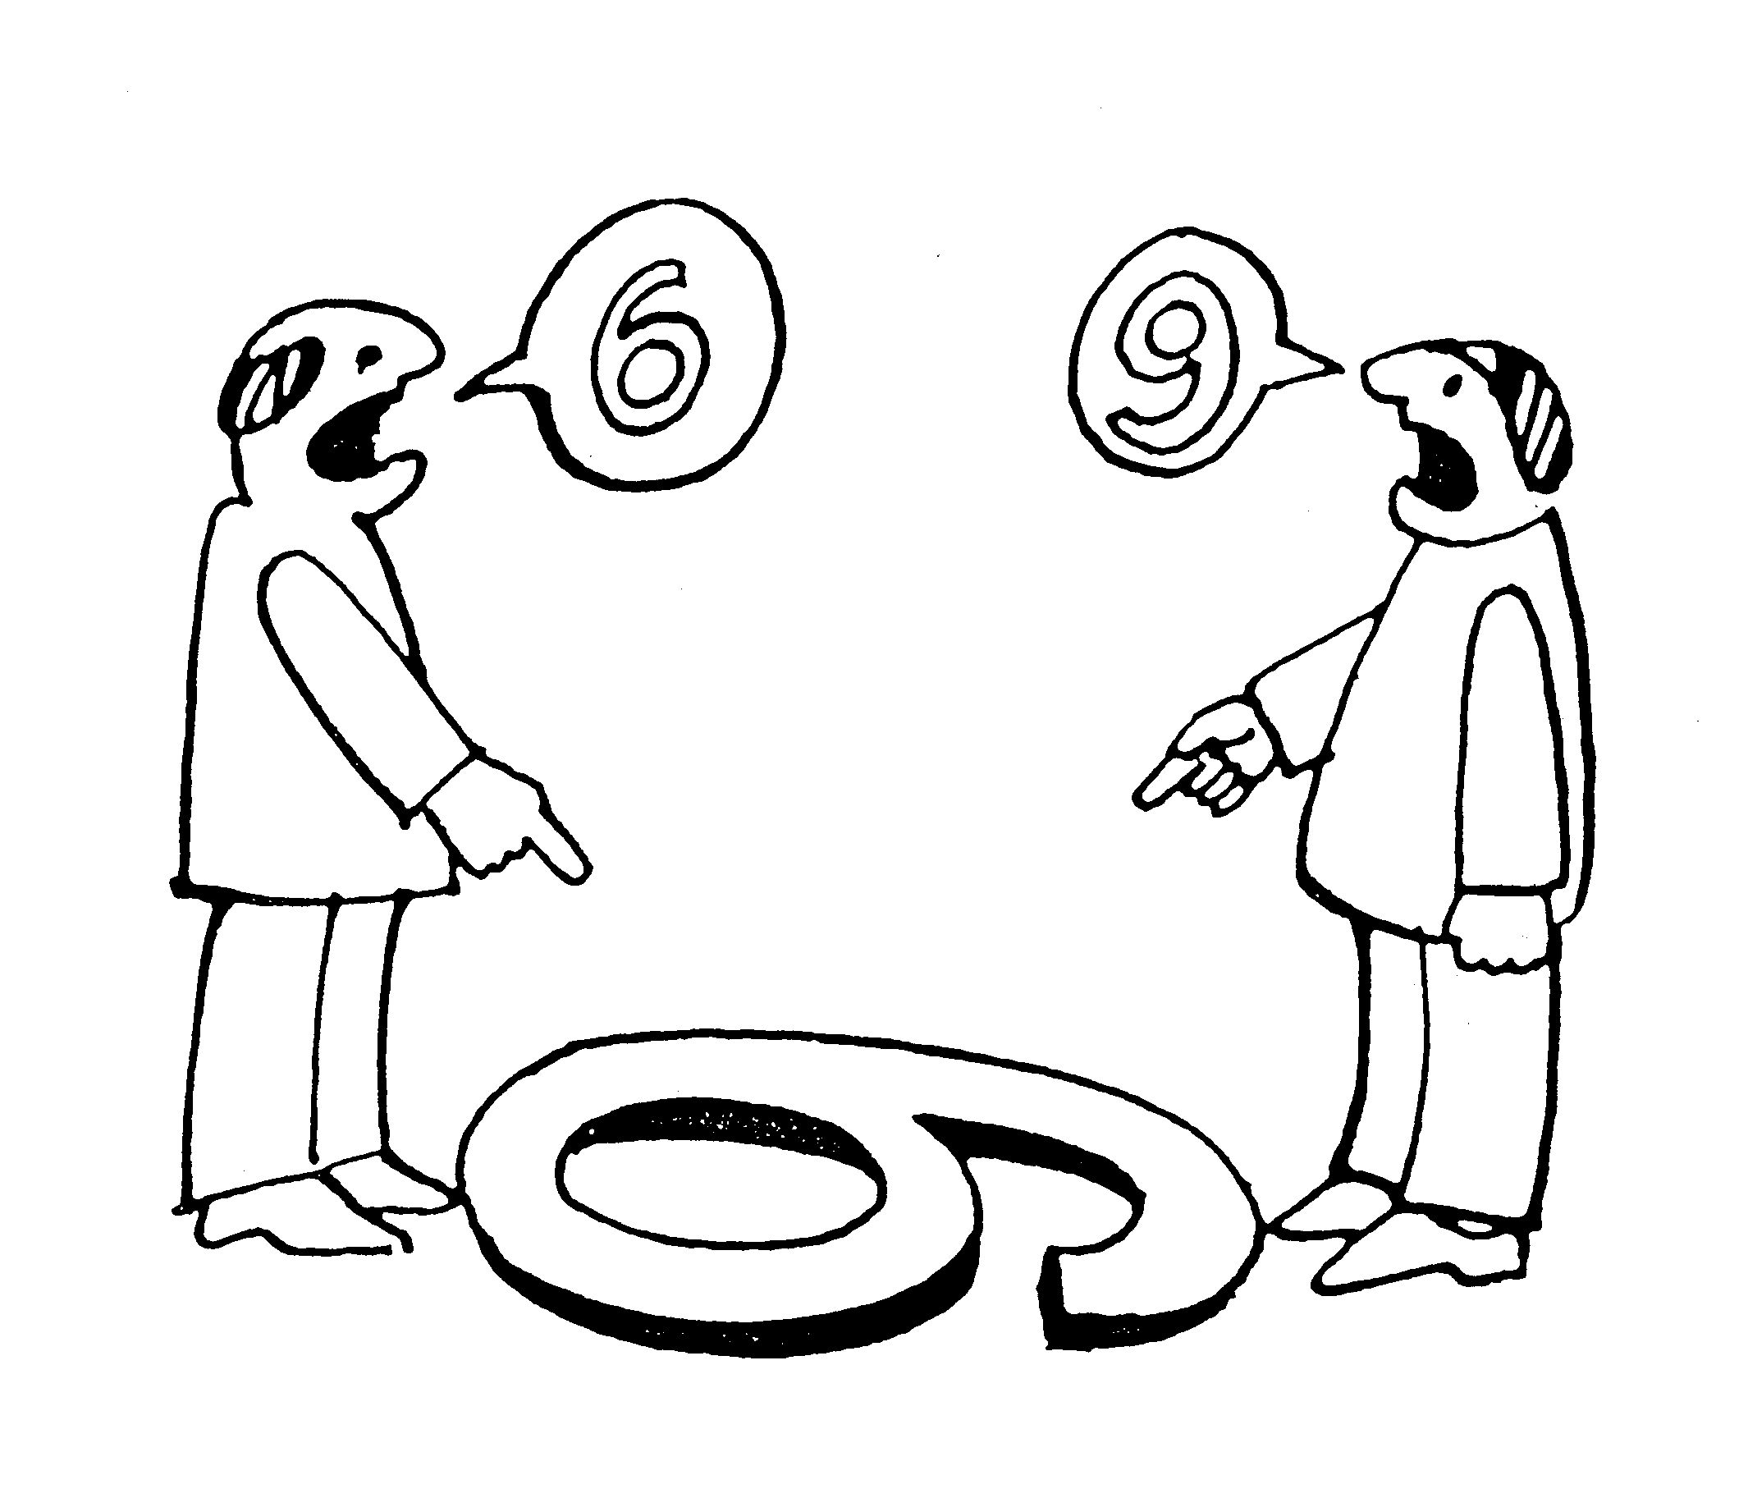
Recognizing the Built-in
Bias of the Report Writer
Unwarranted optimism
Reports are no better than the judgment of the preparer
Reports avoid direct exchange of information
Notes:
The person writing the report will want the report to be accurate but instinctively want to be the bearer or good news, too. Keep in mind that report writers interpret data and relate it to others and their interpretations is subject to bias.
Recognizing the built-in bias of the report writer:
• Report writers tend to lean toward unwarranted optimism
• Reports are no better than the judgment of the person preparing the report
• Reports avoid direct exchange of information
Recognizing the built-in bias of the report writer
• Reports are no better than the judgment of the person preparing the report
Baker and Baker (2000): "Never rely on written reports alone to assess progress on your project. People often leave problems out of reports because they don't want to put them in writing. They also may fail to report schedule slips in meetings because they think time can be made up later. People often don't want to expose a problem in front of others for fear of reprisal or embarrassment. The quality of performance on a project is also subjective. Performance reported as outstanding by one group may be substandard to another" (Pp. 279-280).
• Reports avoid direct exchange of information

Slide 34
Project Meetings
Status update meetings are boring and waste time?
Create an agenda, take minutes and generate action items then track the action items in the next meeting.
Use meetings to look for upcoming risks
Use meetings to get issues on the table and resolve them

Slide 35

Communicate and Coordinate to Let Everyone on the Project Know What’s Expected of Them and How They’re Doing
Notes:
Communication is very important when you are working on a project. With more than 2 people collaborating there needs to be a foundation for discussion and feedback.
Use open-ended questions:
• What persistent problems do you have, and what is being done to correct them?
• What problems do you foresee?
• What additional information do you need?
• What additional resources do you need?
• Do you have any personnel problems now? What personnel problems do you anticipate?
• What events could give you schedule difficulties?
• What would need to happen for your task to be completed early?
• Will your task be completed within the allowed budget, or do you anticipate some overrun?
• How has any work done on your task led to a competitive edge we might use to gain on other businesses?

Slide 36

Establish Checkpoints and Milestones That Tell You Whether or Not Your Project Is On Track
Notes:
Milestones and checkpoints help you monitor the progress of the project. Without these markers you can’t tell how the project is progressing or where it is in the process. You can use several methods of reference for your project.
What qualifies as a checkpoint?
• Checkpoints measure the progress of the project and serve as an essential form of feedback
o These can be measured by task completed
o Resources used
o Budget costs
• Short-term checkpoints are called events
• Long-term checkpoints are called milestones
How to establish checkpoints and milestones that tell you whether or not your project is on track
Reviews
Checkpoints
• Checkpoints measure the PROGRESS of the project and serve as an essential form of feedback
• Short-term checkpoints are called EVENTS
• Long-term checkpoints are called MILESTONES
Baker and Baker say, "Milestones summarize a sequence of tasks or specify a key accomplishment during the project. Milestones are not tasks. Milestones do not take effort; they are just convenient markers for summarizing work that has been performed to that point on the network diagram. The top levels in the WBS are a good source of milestones for the project. Milestones also have defined precedence and sequences. You can draw a network of only milestones, or you can combine milestones with activities to display a complete project-or you can leave the milestones out of your project altogether (recommended only on small projects)" (P. 110).
Your "off-course" warning system

Slide 37
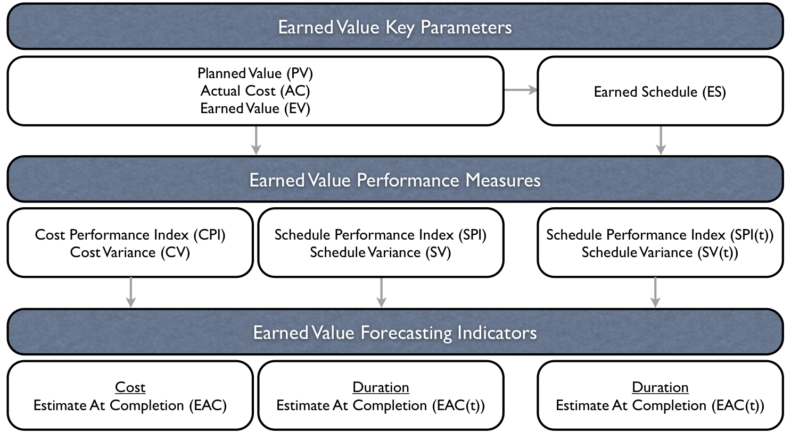
Earned Value Management

Slide 38
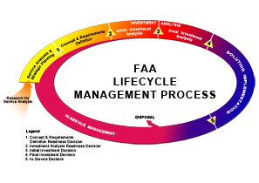
FAA Acquisition Management
Notes:
Mission Analysis
Mission need decision
Investment analysis
Investment decision
Solution implementation (including contracting)
In-service decision
In service management
Service life extension
Change Management
Logistics Support

Slide 39
Step 1: Define the problem
Step 2: Gather data and analyze the problem
Step 7: Celebrate
Seven-step Problem- solving Formula
Step 3: Generate potential solutions
Step 6: Evaluate the solution
Step 4:
Select the solution
Step 5: Implement the solution
Notes:
Problem solving in the business world is a necessity. Using an efficient tool for problem solving will help you generate solutions and maintain control in difficult situations. Using the seven-step problem-solving formula can provide a springboard for generating ideas and innovative solutions.
• Step 1: Define the problem
In 1001 Ways to Take Initiative at Work, Bob Nelson (1999) says, "Is there really a problem? If so, determine exactly what it is, how big it is, and if it is going to continue to be a problem in the future" (P. 25).
• Step 2: Gather data and analyze the problem
Nelson: "Before you start looking for solutions to the problem, gather as much data about it as you possibly can without unduly delaying your efforts" (P. 25).
• Step 3: Generate potential solutions
Nelson: Make a list of the most likely solutions to the problem and prioritize them from most to least likely" (P. 25). Run solutions through a worst-case scenario or a best-case scenario.
• Step 4: Select the solution
Nelson: Choose the most likely solution at the top of your list. Be ready to proceed to the next solution if your first choice does not generate the results you seek" (P. 25).
You might need to set time limits: I must make a decision by the end of this week.
Some people can't select the solution because they haven't learned to trust their instincts. If you have difficulties trusting your instinct (because you've made wrong decisions in the past), take small steps:"
o Do more research into the problem than you normally would
o Use friends as a sounding board
o Practice on small things: Salad or Big Mac? Go through the decision-making process
o Log your decisions and celebrate your successes
o Log your decisions and learn from the wrong ones
o Monitor your decisions more closely
• Step 5: Implement the solution
Nelson: "Put your most likely solution into action. Closely monitor the results to see if it solves your problem. If so, congratulations! You can move on to the next problem. If not, apply the next most likely solution" (P. 25).
• Step 6: Evaluate the solution
• Step 7: Celebrate
Celebrate action. Remember that not doing anything is still making a decision. Most of the time, action will provide its own reward. If you are standing in the middle of a road and you have a truck bearing down on you from one side and a car approaching from the other, your indecision can be deadly. Make a quick decision, stick to the plan, follow-through, and you might be safe.

Slide 40

Use the Principle of “Organized Disagreement” to Ferret Out Creative Alternatives and Solutions

Slide 41
Pitfalls that can impact a project
Scope Creep
Last-Minute Stakeholder
Loss/absence/skills of project resources (people)
Loss of funding or cost increases
Loss of support
Lack of agreement on desired outcome
Changing prioritites
Delays…of all sorts
Unrealistic Planning or deadlines

Slide 42
Common Sources of Conflict in Project Management
Human resources
Equipment and facilities
Capital expenditures and costs
Technical opinions and tradeoffs
Priorities
Administrative procedures
Scheduling
Notes:
Does your project face any of these?

Slide 43

Prepare for the Changing Nature and Intensity of Conflict as the Project Progresses . Improve your skills on conflict resolution…..hint, there is no “bad guy”
Notes:
A big part of the project manager’s job is: Resolving conflict, setting up processes for resolving conflict, and team building, and preventing conflict by constantly staying alert for issues cropping up

Slide 44
What Project Management Software
Can and Can’t Do for You
Can
Software can make planning, modification, contingency planning and updating much easier for complicated projects because it:
Provides you with a Work Breakdown Structure (WBS)
Helps you with task analysis and monitoring
Can’t
Software can’t set goals or objectives, estimate time, or define checkpoints, activities or relationships
The software can make your job easier, but you are the project manager, so you have to know where you’re going and how to work toward your goal
Notes:
Project management is not gantt charts

Slide 45
Red, Yellow, Green
Project reporting is sometimes rolled up in a “dashboard” for upper level reporting
A project manager can sometimes communicate a project’s distress by turning it to red on a dashboard upper management can see.
A project manager’s job is to let management know if a project is not executing as planned

Slide 46
Closing and Celebrating: don’t forget to…
Plan celebrations along the way of major milestones and at the end
Gather lessons learned and present the project formally
Recognize contributors
Formally closing the project and saving data for the future is part of the process—and using data from former projects is one of the methods of estimating future projects

Slide 47
FAA Specific
Within FAA There are three levels of certification
Each has requirements for
  Experience
  Training
  Continuing education
Each level has equivalencies (PMP)
Cert levels are tied to Acquisition Category (ACAT) levels http://fast.faa.gov/docs/acqcattable.doc
Notes:
FAST.faa.gov – under Lifecycle Phases and Decisions – Acquisition Categories - http://fast.faa.gov/docs/acqcattable.doc
“Level I requirements must be met before proceeding to Level II”
EXCEPT … you CAN proceed to Level II directly if you have at least
FAA30010002 – AMS Lifecycle (used to be Intro to AMS or Fundamentals of AMS)
FAA05727 - Appropriations Law Seminar
AND
FAA04200 – COR/COTR Basic Training

Slide 48
Review Certification Levels
On the Certification Portal …
https://ksn2.faa.gov/faa/AcquisitionProfessions/Pages/PPM_Home.aspx
Experience
Training
Equivalencies
Notes:
SO! For employees who are REQUIRED to certify, the Cert office is REQUIRED to provide the needed training, and MMAC is REQUIRED to get them into the classes we offer

Slide 49
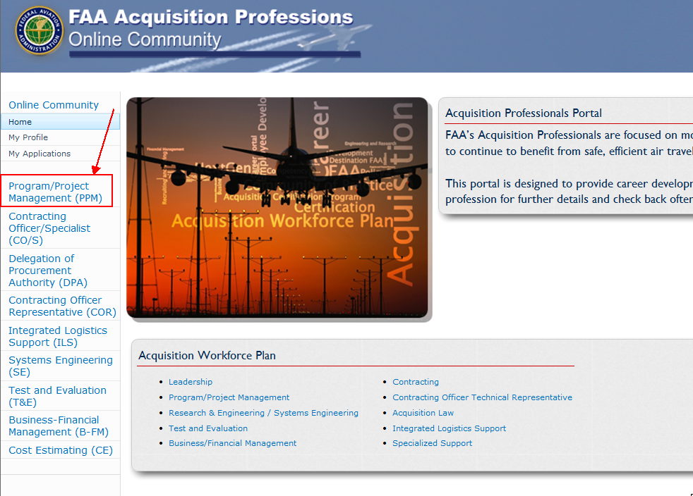
https://ksn2.faa.gov/faa/AcquisitionProfessions/Pages/Default.aspx
Notes:
THIS IS THE PM’s RESPONSIBILITY
https://ksn2.faa.gov/faa/AcquisitionProfessions/Pages/PPM_Home.aspx
Click Program/Project Management (PPM)
Click PPM Home
Create profile

Slide 50
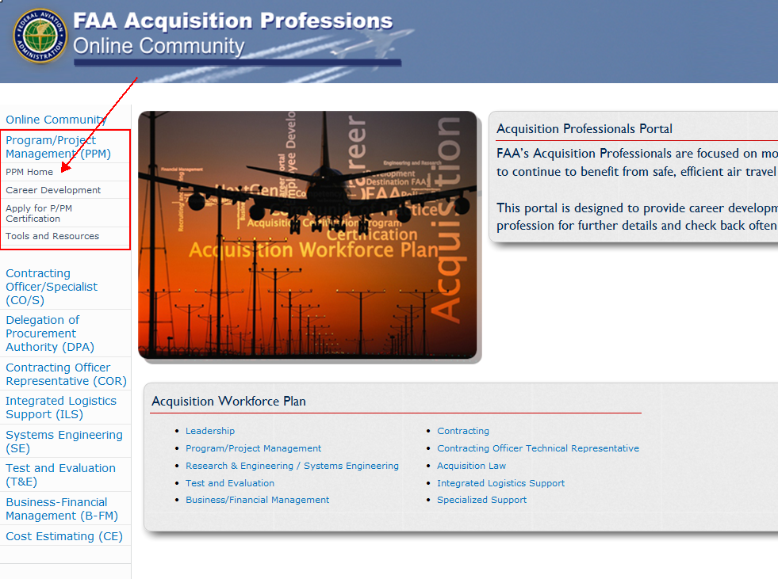

Slide 51
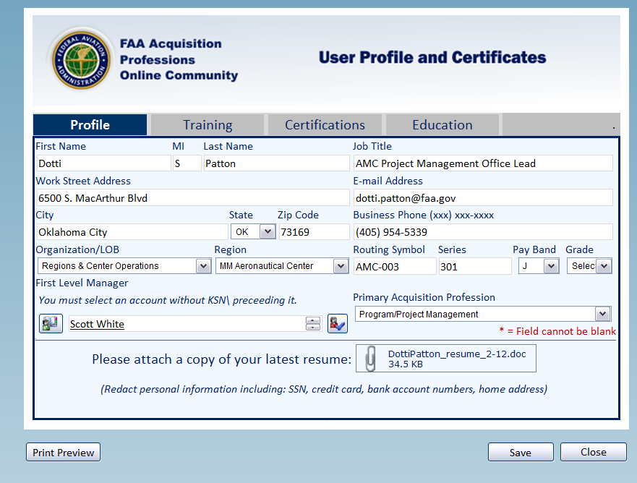
Notes:
When you’re ready to apply,
Create a profile …

Slide 52
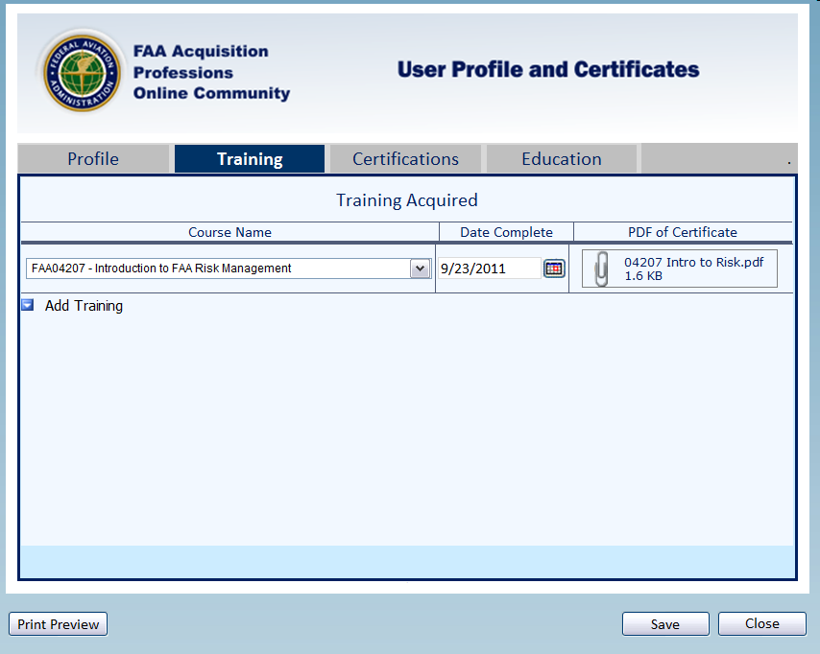
Notes:
Enter your training …

Slide 53
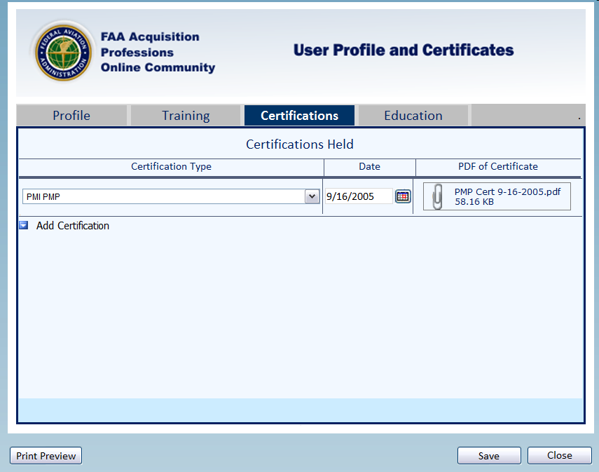
Notes:
Enter your external certifications …
Project Management Institute’s (PMI’s) Project Management Professional (PMP)
or
Defense Acquisition Workforce Improvement Act (DAWIA) Level II or Level III

Slide 54
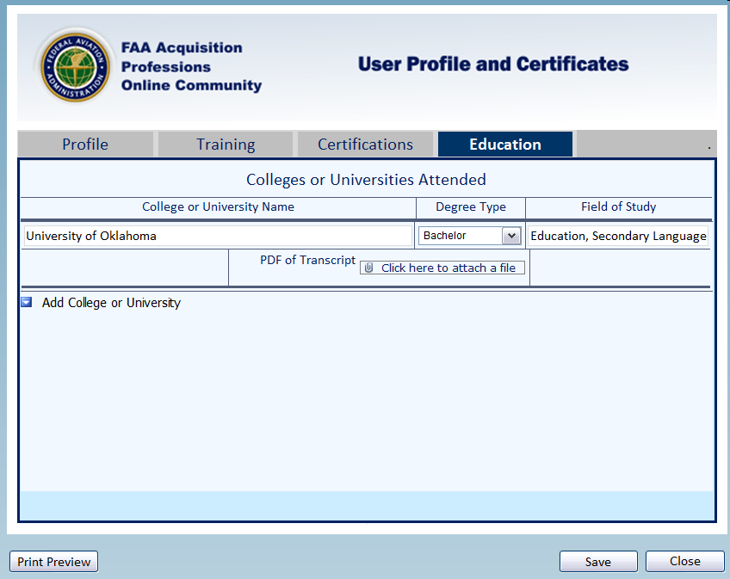
Notes:
Enter your education …

Slide 55
What next?
Please notify your training coordinator if you are seeking your certification.
This information will help them request the right classes for the right people.
Training Coordinators and Management make the decision about who gets agency-funded training.
Notes:
ONLY those who are REQUIRED to certify will get mandatory priority enrollment in certification classes.
All others may use certification as part of their REQUEST/justification. Seeking Cert is NOT a guarantee of a seat in a class.

Slide 56
How I Passed
I read two books twice. I recorded myself reading the books and played the recordings while I was driving.
I read the main study book OUT LOUD to my husband, yes the whole thing.
I did all the skillsoft training on PMP, referring to my books also as I answered the questions on the computer.
I read chapters over and over until I started to “get the flick” of how PMP “thinks”
It looks like common sense at first but there is a specific system of thinking you need to learn

Slide 57
Group Discussion
Would you like to learn more about Project Management ?
Do you see value in the standardization of project management?
Are you a PMP or would you consider becoming a “PMP” through earning the credential through PMI?
Would you consider seeking certification as an FAA project manager?
If yes to any question, how will you go about it, what are the steps?

