Slide 1
Bruce Stewart
Office of Diversity and Inclusion, OPM

Slide 2
Cultural Hunt
Rule 1.
Get out of our Comfort Zone…

Slide 3
Rule 2. Respect other Perspectives
Faces

Slide 4
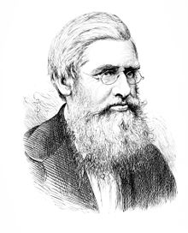
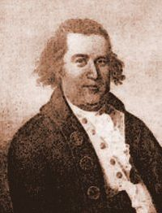
Why are these people not more Famous?
Claudette Colvin
Alfred Russell Wallace
William Dawes
Charles Darwin
Paul Revere
Rosa
Parks

Slide 5
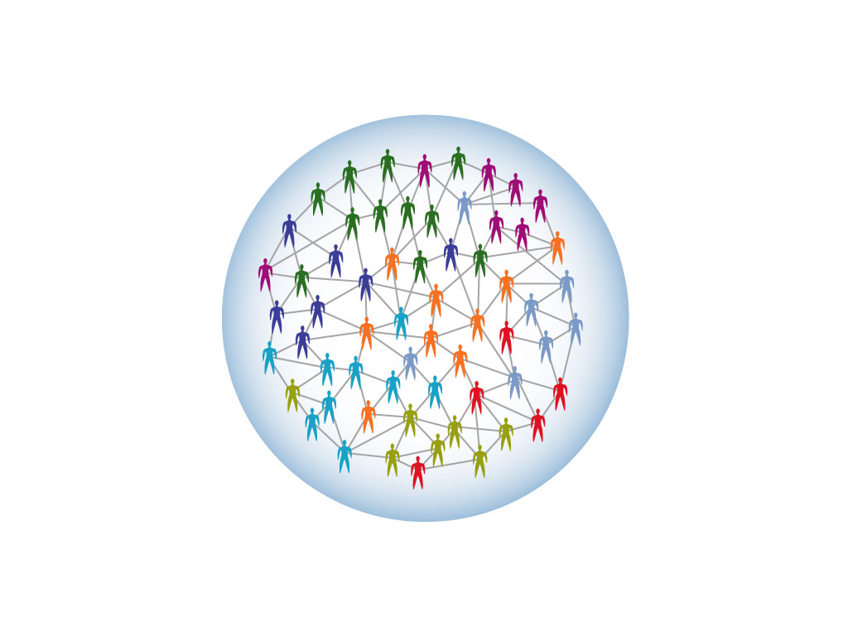
We are Smarter like this…
A stable, robust, high-performance system
Win
Win
Win
Win
Win
Win
Win
Win
Win
Win
Win
A Positive-Sum Game
An interactive networked organization
Win
Win
Win
Win
Win
Win
Win
Win
Win
Win
Win
Win
Win

Slide 6
We are less Smart like this…

Slide 7
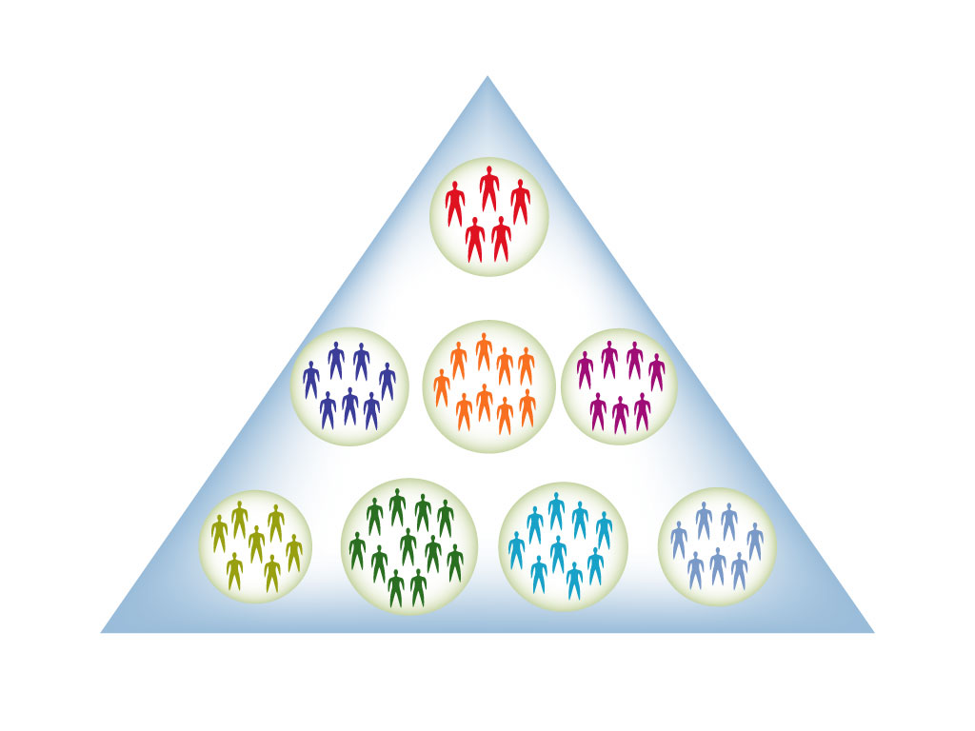
And even less Smart like this…
A fragile, unstable, low-performance system
A hierarchical segregated organization
A Zero-Sum Game

Slide 8
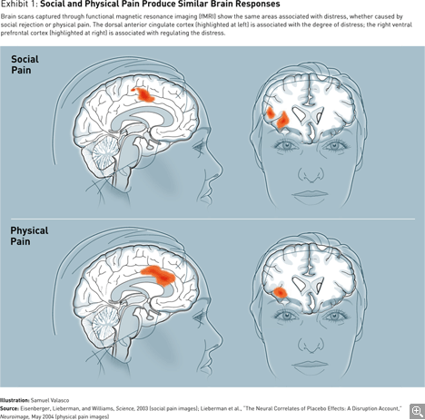
The “Real” Pain of Exclusion

Slide 9
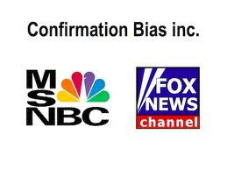
Social Biases that create silos and limit our potential…
“Like Me” Bias
“Confirmation Bias
“Broken Windows” Bias

Slide 10
Is she a bike thief?

Slide 11
The New IQ: Inclusion
Why we-smarts is better than me-smarts

Slide 12
Inclusion Defined
Inclusion is… "the degree to which an employee perceives that he or she is an esteemed member of the work group through his or her needs for belongingness and uniqueness."

Slide 13
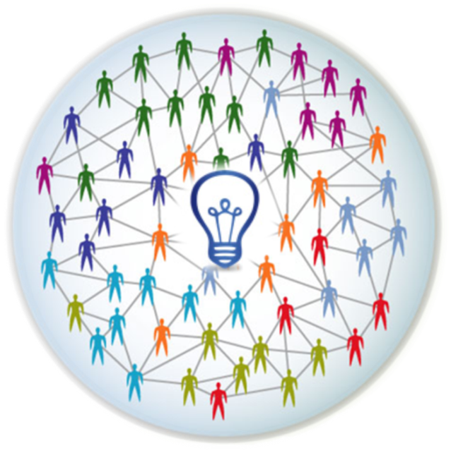
The New IQ = Inclusion Quotient
Measures
Inclusive Intelligence:
The intentional, deliberate, and proactive acts that increase work group intelligence by making people feel they “belong” and are “uniquely” valued.
The New IQ

Slide 14
In with the New and out with the Old…
Individual Smarts is less important
Old IQ
Group Smarts is most important
New IQ

Slide 15
New IQ Perception Scan
 | Behavioral Statement | Score
1 | Others would say I do not tolerate arbitrary actions, personal favoritism and coercion for political purposes.
2 | Others would say I do not tolerate prohibited personnel practices.
3 | Others would say I take steps to deal with poor performers who cannot or will not improve.
4 | Others would say I recognize differences in performance in a meaningful way.
5 | Others would say I give out awards based on how well employees perform their jobs.
6 | Others would say I reward creativity and innovation.
7 | Others would say I actively support policies and programs that promote diversity and inclusion in the workplace.
8 | Others would say I am committed to a workforce representative of all segments of society.
9 | Others would say I work well with employees of different backgrounds.
10 | Others would say I actively promote communication among different work units.
11 | Others would say I actively support collaboration across work units to accomplish work objectives.
12 | Others would say I actively support the needs of Others to balance work and other life issues.
13 | Others would say I regularly provide my subordinates with constructive suggestions to improve their job performance.
14 | Others would say I make time to listen to what they have to say.
15 | Others would say that I treat them with respect.
16 | In the last six months, Others would say I have talked with them about their performance.
17 | Others who depend on me would say they have enough information to do their job well
18 | Others would say I encourage them to come up with new and better ways of doing things.
19 | Others would say their talents are used well in the workplace.
20 | Others have a feeling of personal empowerment with respect to work processes.

Slide 16
The New IQ: 5 Inclusive Habits
Empowerment
Supportive
Cooperative
Open
Fair

Slide 17
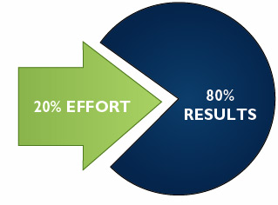
The 80/20 Rule

Slide 18
Trim Tab

Slide 19
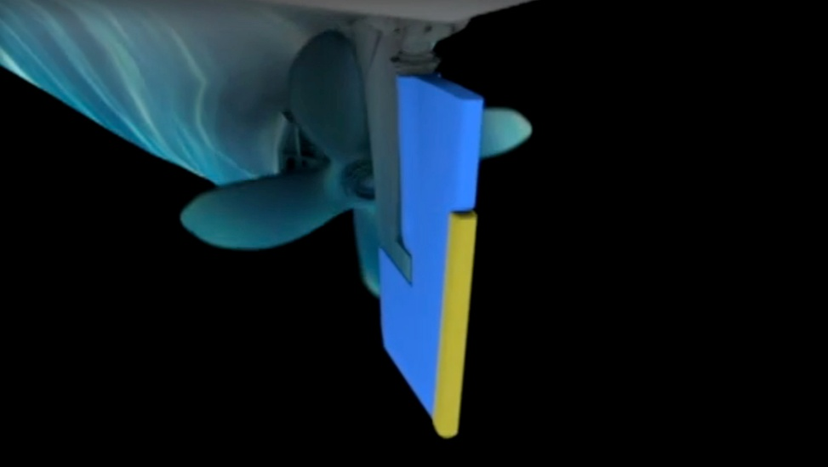
Becoming a Trim Tab at Work
Identify common themes
Using workbook write down examples from video
Discussion of FranklinCovey Trim Tab Video
When thinking about “how can I possibly create change in my organization,” think of being a trim tab. Your small actions, your work in your circle of influence can create, over time, a big impact on your organization.

Slide 20
If you do not intentionally, deliberately and proactively include, you will unintentionally exclude.

Slide 21
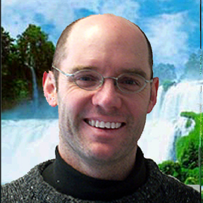
“Progress depends as much on our collective differences as it does on our individual IQ scores”
Scott Page

Slide 22
The Diversity Trumps Ability Theorem
The Difference
Mathematical truth
“collective ability equals individual ability plus diversity” and that diversity trumps ability”

Slide 23
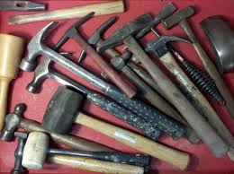
When all you have is hammers…

Slide 24
Everything looks like a nail…

Slide 25
We can do more with an assortment of tools…

Slide 26
A Class Divided

Slide 27
A Class Divided…
Take 3 minutes and write your thoughts on why the kids performed at a lower level in their multiplication game.
Have you ever been impacted by Stereotype Threat?
Get in small groups and discuss your thoughts

Slide 28
Section 1: Inclusion and Leadership
Objective:
Within this section we will discuss what Inclusion really means to us, the two aspects of inclusion, and the basic building blocks to better understand the topic of Inclusion in your workplace
Section 1
Inclusion Defined
Two Aspects of Inclusion
Inclusion Basics

Slide 29
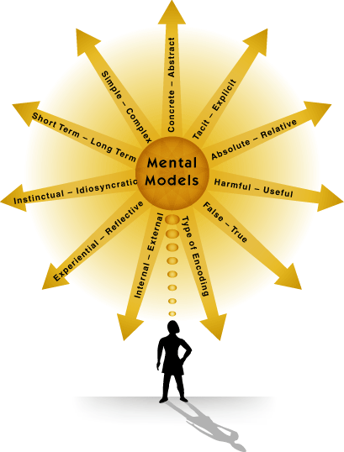
Wrong mental maps lead to wrong solutions which lead to lost resources…

Slide 30
Two Important Aspects of Inclusion
Brewer's Optimal Distinctiveness Theory (ODT). This theory essentially explains the tension that people experience between the need to be a unique individual and the need to belong with others.
Uniqueness
Belonging
Inclusion
It is believed that this tension between belongingness and uniqueness is an underlying theme diversity and inclusion literature

Slide 31
Brewer's Optimal Distinctiveness Framework
 | Low Belongingness | High belongingness
High value in uniqueness | Differentiation: | Inclusion:
 | Individual is not treated as an organizational insider in the work group but their unique characteristics are seen as valuable and required for group/ organization success. | Individual is treated as an insider and also allowed/ encouraged to retain uniqueness within the work group.
Low value in uniqueness | Exclusion: | Assimilation:
 | Individual is not treated as an organizational insider with unique value in the work group but there are other employees or groups who are insiders. | Individual is treated as an insider in the work group when they conform to organizational/ dominant culture norms and downplay uniqueness.
Individuals experience feelings of inclusion when a high value is placed on uniqueness with a corresponding high value on belongingness

Slide 32
Inclusion and Leadership Exercise
Think about a time when you the leader of a successful team.
What were the characteristics that supported the team’s success?
How did people treat each other?
What was your role as a leader of the team and how did you enable team success?

Slide 33
Section 2: Foundations of New IQ
Objective:
In this section you will be introduced to the New IQ , the brain science behind inclusion, and the importance of the Inner Work Life System.
Section 2
The New IQ Defined
The Neuroscience of Inclusion
The SCARF Model of the Brain
The Inner Work Life System

Slide 34
The logic of diversity and inclusion
Diversity is not an imposition, it’s an advantage
Inclusion is not a problem, but it’s a solution
Working together is more than a good idea, it’s essential to individual and company success

Slide 35
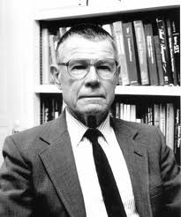
Thomas Schelling Segregation: background
In many (American) cities, races segregate
This has unwanted consequences
Why does this happen, and what can we do about it?
Main idea: this is because people don’t like each other
If that would be true, high-tolerance cities would have lower segregation than low-tolerance cities …
… but empirically this does not hold.

Slide 36
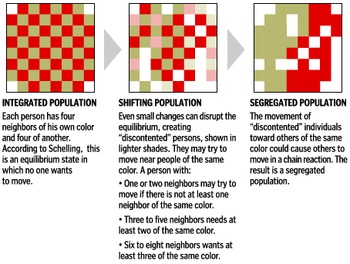

Slide 37
Schelling’s conclusion
Harsh preferences are not necessary to create segregation. In other words: ever under ‘mild’ circumstances, segregation can occur
And the simulation shows that segregation also depends on for instance how full the checkerboard is (if crowded, moving is more difficult)

Slide 38
Rule 3. We are Smarter Together
Innovation Quiz

Slide 39
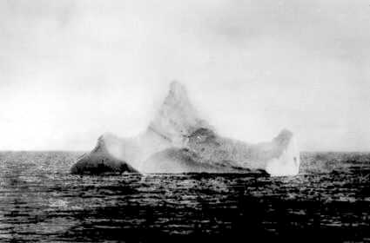
Newspapers from the time estimated the size of the iceberg to be between 50-100 feet high and 200-400 feet long. Titanic was navigable for awhile and could have pulled aside the iceberg. Many people could have climbed aboard it to find flat places to stay out of the water for the four hours before help arrived. Fixated on the fact that icebergs sink ships, people overlooked the size and shape of the iceberg (plus the fact that it would not sink).

Slide 40
Remember…
Diversity + Inclusion = Better Performance
Diversity
Inclusion
Better Performance
by accelerating the Inner Work Life

Slide 41
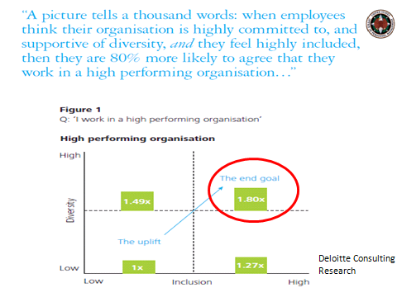
Research for example…
Conducted by Deloitte Australia

Slide 42
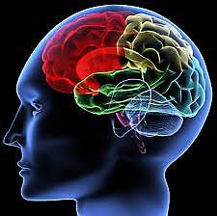
Neuroscience of Inclusion
FACT: Our brains are
wired for efficiency and speed.
This basic wiring of the brain can work against us in communicating and working effectively across differences.
FACT:
The neocortex is the area of the brain where we can imagine a new reality, where compassion and empathy reside.
The competence of inclusion lies in our ability to intentionally access the neocortex. When we learn to recognize and manage our brain states, we increase our effectiveness in communicating and working together across differences and build new neuropathways.
FACT: Neuroscience research shows that our brain state directly impacts our perception.
Our brain states impacts how we perceive others, events and our ability to foster relationships across differences.

Slide 43
Brain Tricks

Slide 44
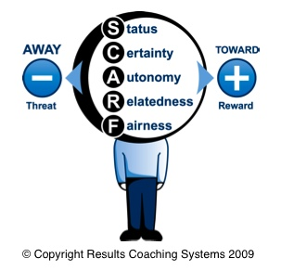
The SCARF Model of the Brain
Model of Social Threats and Rewards

Slide 45
Perceptions
Emotions
Motivations

Slide 46
Inner Work Life System
Inner Work Life
Perception
Emotion
Motivation
“People do better work when they are happy, have positive views of the organization and its people, and are motivated primarily by the work itself.” (p, 47)
“The Progress Principle”

Slide 47
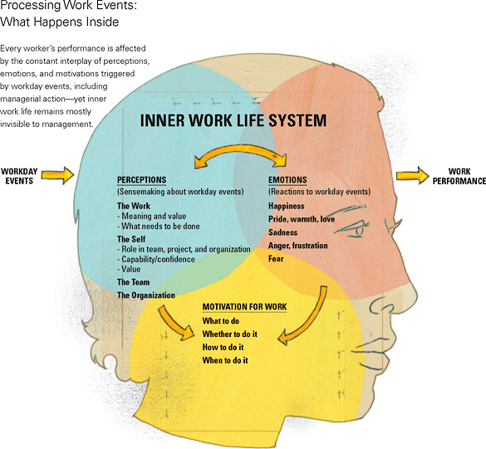

Slide 48
Inner Work Life: Key Points
Every worker’s performance is affected by the constant interplay of perceptions, emotions, and motivations triggered by workday events, including managerial action-yet inner work life remains mostly invisible to management
Even seemingly mundane events – such as small wins and minor setbacks – can exert potent influence on inner work life
Negative events
are more powerful than positive events, all else being equal

Slide 49
Exclusion Exercise
Take a moment to reflect on a time when you were excluded or felt like an outsider. Most people can remember a time when they were kids and felt the pain of exclusion. Or, maybe there was a time at work when you were left out of the group. Not invited to lunch, or left out of an important project. See workbook for additional instructions
In-group
Out-Group

Slide 50
Section 3: The 5 Habits of Inclusive Leadership
Objective:
In this section you will cover the 5 Habits of Inclusive Leadership
Section 3
The New IQ: 5 Inclusive Habits

Slide 51
The New IQ: 5 Inclusive Habits
Empowerment
Supportive
Cooperative
Open
Fair

Slide 52
The New IQ Logic to change culture through behavior change
20 Behaviors
5 Habits
Culture Change
Inclusive Environment

Slide 53
New IQ Scores
Government Average
44% | 56% | 55% | 74% | 59%
Fair | Open | Cooperative | Supportive | Empowered

Slide 54
Habits sustain
performance culture…

Slide 55
Section 4: Making Habits Stick
Objective:
In this section you will identify target behaviors and create new pathways for positive habits
Section 4
Identify Target Actions
Use 3 Step Method to New Habit
Shape Environment
Identify Measurement System

Slide 56
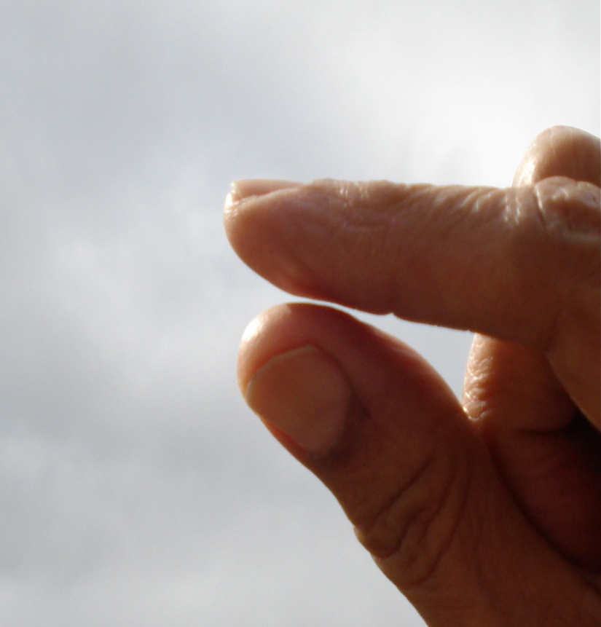
3 Small Steps to Creating Habits
1. Shrink the change
2. Find a spot
3. Train the cycle everyday
Shape your environment

Slide 57
But First, Your Story…
Who: Who were your parents? Grandparents? History?
What: What were the 3 events growing up that impacted you the most?
When: When were you born? Generational memories
Where: Where were you born? Spent most of your time growing up? Memories?
How: How were you raised? Parents or Grandparents? Strict? Religious?
Why: In your opinion why do good or bad things happen to people?

Slide 61
The New IQ Perception Scan
Complete the following New IQ Inclusive Intelligence Perception Scan using a scale of 1-5 (never, rarely, sometimes, often, always)
 | Behavioral Statement | Score
1 | Others would say I do not tolerate arbitrary actions, personal favoritism and coercion for political purposes.
2 | Others would say I do not tolerate prohibited personnel practices.
3 | Others would say I take steps to deal with poor performers who cannot or will not improve.
4 | Others would say I recognize differences in performance in a meaningful way.
5 | Others would say I give out awards based on how well employees perform their jobs.
6 | Others would say I reward creativity and innovation.
7 | Others would say I actively support policies and programs that promote diversity and inclusion in the workplace.
8 | Others would say I am committed to a workforce representative of all segments of society.
9 | Others would say I work well with employees of different backgrounds.
10 | Others would say I actively promote communication among different work units.
11 | Others would say I actively support collaboration across work units to accomplish work objectives.
12 | Others would say I actively support the needs of Others to balance work and other life issues.
13 | Others would say I regularly provide my subordinates with constructive suggestions to improve their job performance.
14 | Others would say I make time to listen to what they have to say.
15 | Others would say that I treat them with respect.
16 | In the last six months, Others would say I have talked with them about their performance.
17 | Others who depend on me would say they have enough information to do their job well
18 | Others would say I encourage them to come up with new and better ways of doing things.
19 | Others would say their talents are used well in the workplace.
20 | Others have a feeling of personal empowerment with respect to work processes.
Notes:
D&I are also fostered by having Openness as a way of doing business. In an open work environment, creativity and innovation are rewarded, policies and programs promote diversity in the workplace and supervisors and team leaders are committed to a workforce drawn from all segments of society as they work well with employees of different backgrounds
In a Cooperative work environment, managers promote communication among different work units to support collaboration across work units to accomplish work objectives.
When supervisors are Supportive, it means that supervisors support the need to balance work and other life issues. Supervisors and team leaders have to provide employees with construction suggestions to improve their job performance and talk with employees about their performance every 6 months. Supervisors and team leaders take the time to listen to what employees have to say and treat employees with respect.
The last FOCSE habit is Empowerment. In an inclusive workplace, employees have enough info to do their jobs and will feel encouraged to come up with new and better ways of doing things. In an empowered work setting, employees’ talents are well used and employees have a feeling of personal empowerment with regards to their work processes

Slide 62
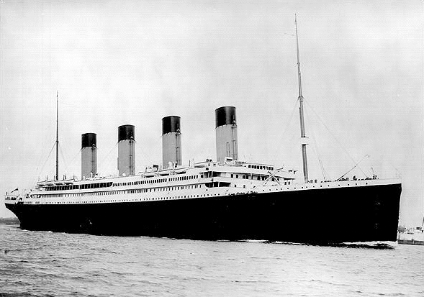
The Titanic

