Slide 1

Developing Self and Others
Presented to: NHCFAE
Presented by: Ali McDermott, Group Manager
Employee Development, AJG-L3
Presented on: August 07, 2019

Slide 2
Learning Outcomes
1
Assess and reflect on your own skills, abilities and experience
Support others to develop their knowledge, skills and behaviors to enable them to reach their full potential
2
Make effective use of available resources relative to training and development
3
4
Empower a responsive, innovative workforce of the future that benefits the entire organization

Slide 3
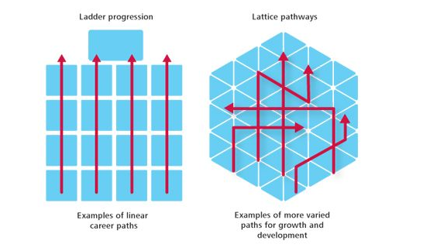
Ladder vs Lattice

Slide 4
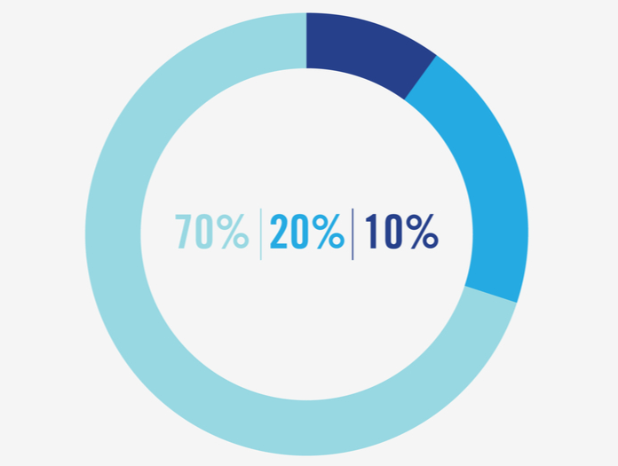
Use 70:20:10 Learning & Development Model
Feedback / Relationships (20%)
Mid and end-of-year performance discussions
Networking
Mentoring
Coaching
Professional or trade associations
Work Experience (70%)
Special projects
Stretch assignments
Rotational assignments
Managing complexity
Leading cross-functional
initiative
Volunteer/community involvement (STEM)
70% 20% 10%
Training (10%)
Instructor led, self study courses
Blogs, videos, audiobooks,
Workshops, conferences
Certificate programs

Slide 5
Individual Development Plans / Management Development Plans
COMING SOON!!!!!!!
IDPs will be easily accessible on the LMS homepage, no log in required
PDF options will include the FAA and ATO versions
Currently in testing and will be available in the next few weeks

Slide 6
Individual Development Plans / Management Development Plans
LMS IDP Course ID FAA30202642

Slide 7
Individual Development Plans / Management Development Plans

Slide 8
All Employees
Aspiring Frontline Managers
Frontline Managers
All Managers
Middle Managers
Senior Managers
Aspiring Executives
Executives

Slide 9
Start Your Journey Here
myatocareer.faa.gov

Slide 10
ATO Career Planning
CPT2 Video

Slide 11
ATO Career Planning

Slide 12

ATO Career Services Center (CSC)
Online and offline career planning and development support
Empowers employees to explore their career interests
Delivers career-related webinars and face-to-face sessions
Schedules one-on-one informational sessions
    CSC Webpage

Slide 13
Interview Stream Tool
Record interviews, self review, or seek feedback from others
Expert tips and videos on interviewing techniques
Library of over 7,000 interview questions, including behavioral based options
Practice interviewing skills by creating mock interviews anytime, anywhere
Online video interviewing platform

Slide 14
ATO Learning and Development Resource Guide
Detailed summary of External, FAA, and ATO employee development programs and services
Provides links to program web sites and points of contact
Helpful resource for managers to develop others
Updated quarterly
Access latest version from the ATO Leadership and Employee Development homepage

Slide 15

FAA Degree Completion Program (DCP)
Part of the agency’s Tuition Reimbursement Program
Aids up to 50 FAA employees in completing a degree they started but haven’t finished
Provides up to $4K annually for up to 5 years, if approved
Connects degree relevance to future organizational needs

Slide 16

FAA Employee Associations and Special Emphasis Programs
Employee Associations (EAs) | Special Emphasis Programs
FAA GLOBE (LGBTQIA) | Federal Women’s Program (FWP)
Native American/Alaska Native (NAAN) | Federally Employed Women (FEW)
National Asian & Pacific American (NAPA) | Hispanic Employee Program (HEP)
National Black Coalition of Federal Aviation Employees (NBCFAE) | People with Disabilities Program (PWDP)
National Coalition of Federal Aviation Employees w/Disabilities (NCFAED)
National Hispanic Coalition of Federal Aviation Employees (NHCFAE)
Professional Women Controllers (PWC)
Technical Women’s Organization (TWO)

Slide 17

Reduced College Tuition Program (RCTP) – Federal Academic Alliance
15 colleges and universities across the U.S. currently partnering with OPM
Targets federal employees, their spouses and some dependents
Provides 5%-50% tuition reduction for certificate programs, undergraduate and graduate degrees
Closes critical skill gaps in mission critical occupations with talent development opportunities

Slide 18
Rotational Assignment Programs (RAPs)
Program Elements
White House Leadership Development Program
President’s Management Council Inter-agency Rotation Program
DOT Departmental Rotation Assignment Program
FAA Executive Exchange Program: Making Strategic Connections
Benefits
Gain federal perspective on high-priority challenges and access to senior decision-makers
Develop skillsets and networks to address challenges and implement solutions across organizational boundaries
Help implement specific Administration initiatives requiring cross-government coordination and long-term strategic planning
Rotational Assignment Program

Slide 19


Skillsoft Resources
Flexibility of accessing learning from your computer
Builds individual and organizational talent
Enhance leadership skills and develop professionally
Supports the FAA’s “Workforce of the Future” Strategic Initiative
Access to an array of self-paced learning resources and courses

Slide 20

Science, Technology, Engineering and Math (STEM) Aviation and Space Education Program (AVSED)
Enhances FAA workforce leadership and business acumen
Inspires future generations to become part of the aviation and aerospace community
Builds relationships with local and national networks
Addresses agency workforce shortages
Offers exposure to STEM-based programs and leaders in various communities

Slide 21
All Employees
Aspiring Frontline Managers
Frontline Managers
All Managers
Middle Managers
Senior Managers
Aspiring Executives
Executives

Slide 22


Leaders at all levels
Technical Operations Leadership Development Program (TOLDP)
Technical job series employees who are interested in moving into first-level management and developing the leadership competencies needed to be effective
Air Traffic Leadership Development Program (ATLDP)
Provides realistic job preview and leadership development for Certified Professional Controllers that are interested in the job of Front Line Manager
Program for Emerging Leaders (PEL)
Rigorous 8 to 9-month leadership development program open to full-time, non-supervisory employees and is part of the FAA's commitment to developing leaders at all levels

Slide 23
All Employees
Aspiring Frontline Managers
Frontline Managers
All Managers
Middle Managers
Senior Managers
Aspiring Executives
Executives

Slide 24
Succeeding in Your First Year (SYFY)
One week session held after FAA’s New Manager Course (NMC)
Provides participants with the knowledge and skills to successfully achieve their core responsibilities
Strives to develop consistent, capable, and confident leaders who drive safety, productivity, quality and engagement
Covers organizational alignment, performance management, developing self and others, labor relations, collaboration, safety and transition from an individual contributor to a manager
Targets new ATO Managers within 90 days of selection
SYFY Homepage

Slide 25
Frontline Managers Operations Workshop (FLMOW)
Developed and facilitated by Frontline Managers
Provides peer-to-peer learning on the day-to-day nuts and bolts of the job
Required every three years for Technical Operations Frontline Managers
Topics include: leadership and management, logistics, facility operations, Human Resources, training and certification
FLMOW

Slide 26
Operations Supervisor Workshop (OSW)
Developed and facilitated by Operations Supervisors for Operations Supervisors
Provides peer-to-peer learning on the technical and leadership challenges unique to the Operations Supervisor position
Required as soon as possible for new Operations Supervisors and every 3 years thereafter
Topics include: LMR, safety, performance management, conflict management and leadership training
OSW

Slide 27
Technical Operations Supervisors’ Committee (SUPCOM)
Serves as an advocacy group that influences NAS improvements that meet the goals of FLMs, execs, and other Service Units
Serves as a conduit for communication, both up and down
Provides an ability to influence improvements in operations that meet agency goals
Allows members to leverage professional knowledge and operational perspectives to lead the organization
Builds professional networks
AJW SUPCOM

Slide 28

Air Traffic Supervisors’ Committee (SUPCOM)
Group representative of the 1800 frontline Air Traffic Operations Supervisors driving change in the ATO, essential to Air Traffic Operations
Identify and raise concerns, provide input to FAA field, Service Areas, and National Officers and actively participate in the decision making process for achieving FAA and ATO goals

Slide 29
All Employees
Aspiring Frontline Managers
Frontline Managers
All Managers
Middle Managers
Senior Managers
Aspiring Executives
Executives

Slide 30

ATO Succession Planning Program
Forms talent pools to develop managers who demonstrate high potential for success in specific leadership positions
Increases leadership bench strength
Improves key talent engagement
Increases employee’s proficiency in critical competencies

Slide 31

Leaders Teaching Leaders (LTL)
Drive management conversations around ATO vision, strategies and desired changes
Lead from where you are, leadership challenge of change, leading change in performance management
Improves performance of intact management teams, develops self and others and moves the ATO culture toward the ATO vision
Facilitated by senior leaders (Air Traffic General Managers and Tech Ops District Managers) emphasizing joint deliveries

Slide 32
FAA Leadership & Learning Institute (FLLI)
Prepares managers to lead the agency into the future through continuous learning
Addresses critical need to develop an engaged and energized workforce
Serves as the agency’s leadership development center

Slide 33
All Employees
Aspiring Frontline Managers
Frontline Managers
All Managers
Middle Managers
Senior Managers
Aspiring Executives
Executives

Slide 34
Operations Manager Leadership Development Program (OMLDP)
Develop strategic organizational alignment, foster growth in relationships with peers, Air Traffic Managers and subordinates, and convey the criticality of developing self and others
Identify blind spots and provide tools to bring them into focus with the Blind Spot Action Plan (BSAP)
Designed to clarify the role of Operations Managers including preparatory tasks, a 3 day workshop, and documentation of real world implementation of their transfer of learning upon return to their facility
OMLDP

Slide 35
All Employees
Aspiring Frontline Managers
Frontline Managers
All Managers
Middle Managers
Senior Managers
Aspiring Executives
Executives

Slide 36

OPM Center for Leadership Development
Foster exchange of ideas and resources government-wide
Multilevel leadership development
Leadership Education and Development (LEAD) Certificate Program
Develop visionary leaders to transform government

Slide 37
All Employees
Aspiring Frontline Managers
Frontline Managers
All Managers
Middle Managers
Senior Managers
Aspiring Executives
Executives

Slide 38

Senior Leadership Development Program (SLDP)
12-18 month agency wide leadership development program
Targets GS-15 or equivalent, K, L, M Bands or MSS-3 and above
Multi-rater feedback and assessment activities to help identify critical development needs
Professional coaching and partnering with FAA executive advisor
Program workshops, executive education coursework, developmental assignments and or an action learning project

Slide 39


Federal Executive Institute (FEI)
Targets GS-15 or equivalent, K, L, M Bands
Expands professional networks, enabling inter-organizational collaboration and problem solving
Leadership development in team building, strategic thinking, influencing, political savvy and external awareness
Increases self awareness as an individual, team member and leader

Slide 40

Executive Core Qualifications (ECQ) Writing Support
Craft ECQs based on the CCAR model
Review and download at anytime
Understand the alignment and differences between the ECQs and the Managerial Success Profile
ECQ Writing Presentation

Slide 41
All Employees
Aspiring Frontline Managers
Frontline Managers
All Managers
Middle Managers
Senior Managers
Aspiring Executives
Executives

Slide 42

FEE: Leading in the FAA
Network, discuss current and future FAA challenges and learn skills essential for success
Develop communicating effectively and executive related skills
Three-day interactive workshops required for new executives and encouraged for experienced executives

Slide 43
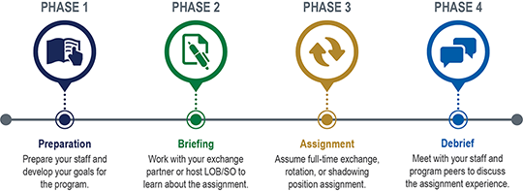
Executive Exchange Program (EEP)
10-week program with 4-6 weeks in an exchange, rotation or shadowing assignment in a different Staff Office or Line of Business executive role
Targets FAA Executives with at least 9 months of FAA experience and aspirations to advance (but no current plans to retire)
Creates cross-agency communication, innovative solutions to FAA challenges and builds diversity in the executive corps

Slide 44
    Competency Development
    FAA Strategic Leadership Capabilities
    OPM Leadership Competencies
    OPM Job Specific Competency Models
    Resume and Interviewing Skills
        Accomplishment Builder
        Behavioral Interviews
        InterviewStream and Download
        Resume Writing Video
    Networking & Mentoring
        FAA Employee Associations
        Professional Association Finder
        Informational Interviews
        Tips on Finding a Mentor
        Networking Secrets
Resources
    Accomplishment Training
    Accomplishment Tracking Guidance
    Education & Training
        American Management Association Powerful Body Language Tips and More
        Coursera Offers Free Non-Credit Courses
        edX.org Hosts Online University-Level Courses, Including Some At No Charge
        Ted Talks That Will Improve Your Work Life (from Select International)
        Interpersonal Skills (Life Skills You Need)
        OPM Government-Wide Academic Alliances
        University Webinars on Discount Education
        Your Office Coach: Secrets to Politically Savvy People and More
        Access Lynda.com Via Your Public Library
    ATO Virtual Learning (AVL)
    Intro to ATO Virtual Learning AVL (Video)
    AVL Tool Home Page
    Career Tools
    MyATOcareer
    O*Net OnLine Career Exploration
    USAJobs.gov
    Transferable Skill Sets for Job Seekers
    Transferable Skills Checklist
    FAA Learning Portals
    FAA eLMS Portal SkillSoft Courses and Books 24x7
    FAA Acquisitions Professions Portal
    FAA Leadership & Learning Institute

Slide 45
Summary
Meet current and future agency needs by developing yourself and others
Align with the FAA’s “Workforce of the Future” Strategic Priority
Use and share information, resources, and tools for continuous development

Slide 46

Ali McDermott, Group Manager
Employee Development, AJG-L3
202.267.6646
Thank You

